Slide 1




Crime and Weather in Chicago 2016
Jane Gan, Komal Masood
Gerard Fullsack, Jaime Rodriguez

Slide 2



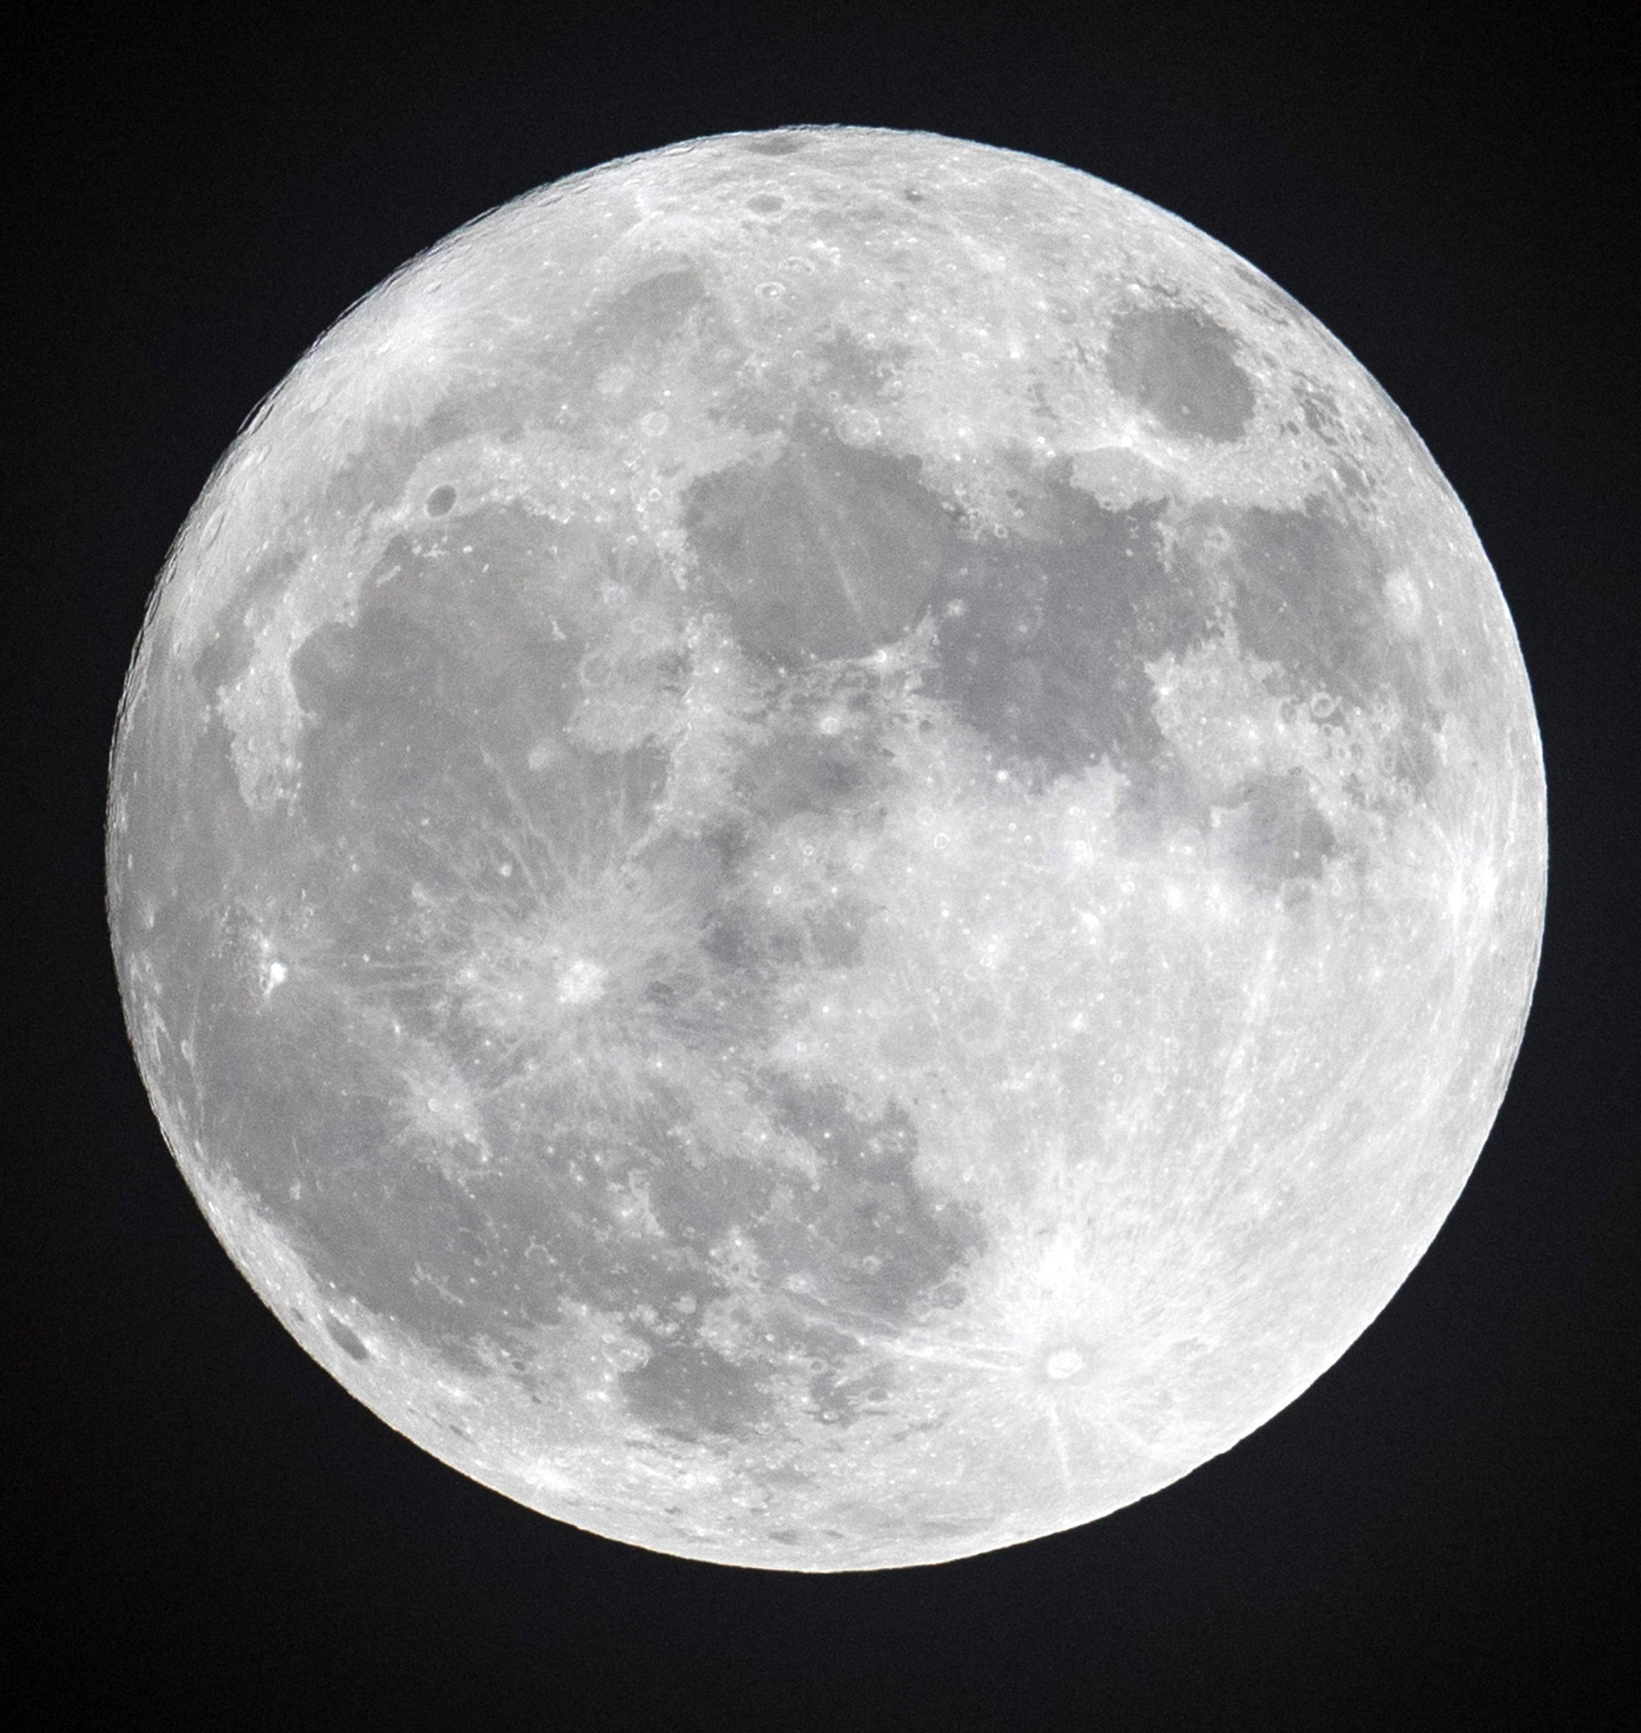



Picking a topic…

Slide 3
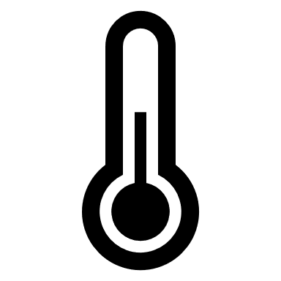




Questions
Is there a correlation between temperature and crime?
Is there an association between type of crime and temperature?
Are there more violent crimes in hotter weather?
Is there an optimal temperature for crime?
Do the months or time influence crime?
We predict that crime will decrease in extreme temperatures and types of crime will be influenced by temperature (i.e. more violent crimes in hotter weather).

Slide 4




Sources and Parameters
Kaggle CSV’s
Weather stats
Crime stats
Legalmatch.com
Justia.com

Slide 5
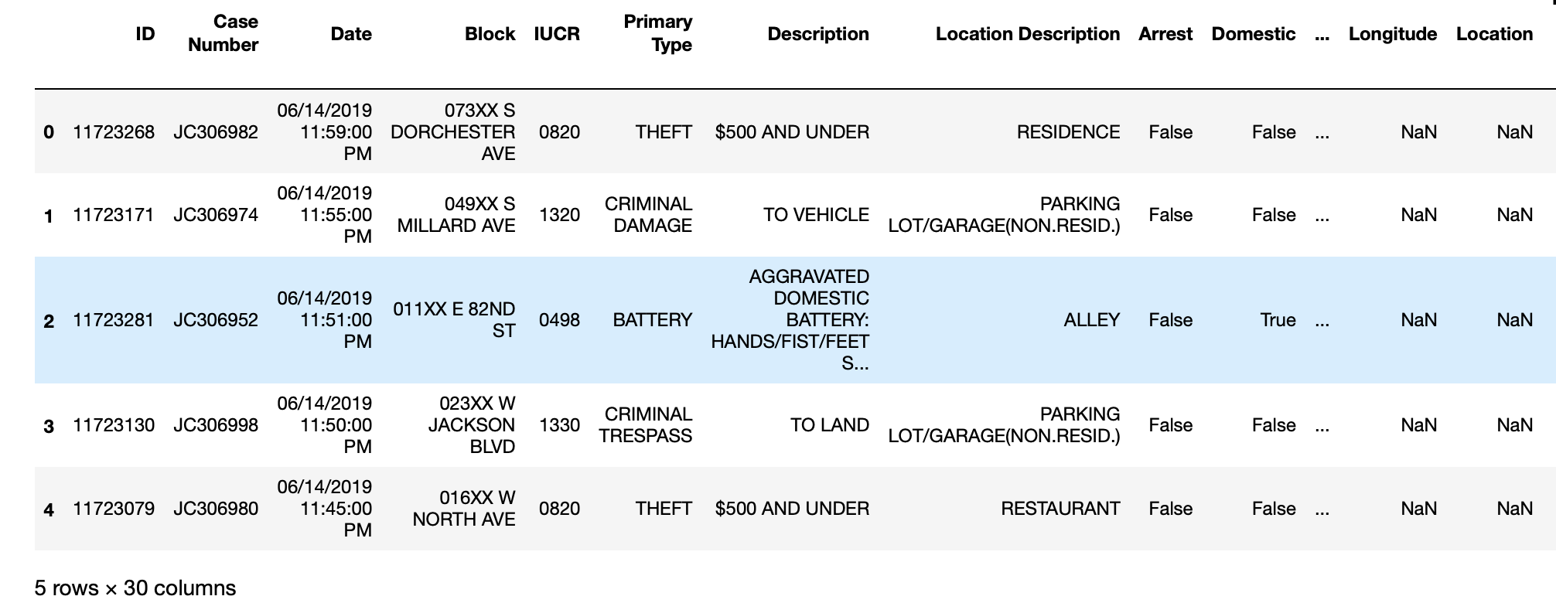
Clean data - Crime stats
Total 30 columns.
We use 4 columns: case number, date, primary type and year

Slide 6
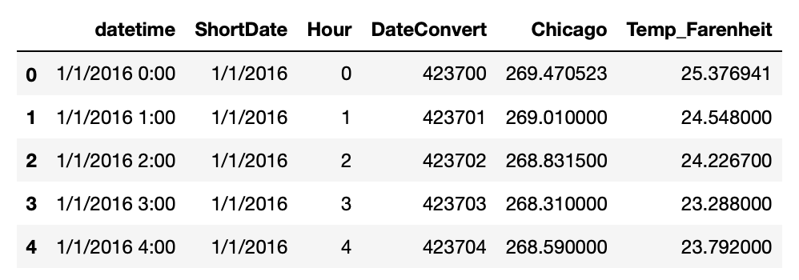
Clean data - Weather stats
The weather data is from OpenWeatherMap. It has weather data for major cities by day and hour.
We choose 2016 Chicago data.

Slide 7
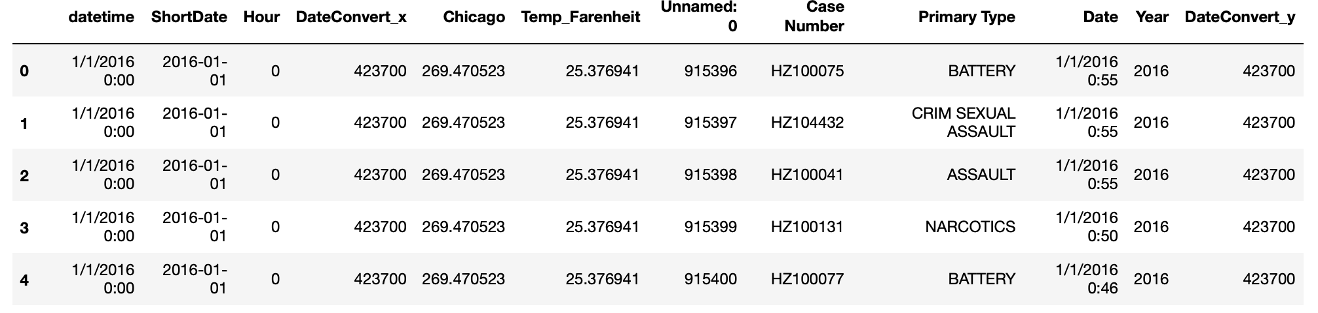
Clean data – combine data (1st merge)
Weather stats and Crime stats are merged on “ShortDate” and “Hour”
The keys

Slide 8
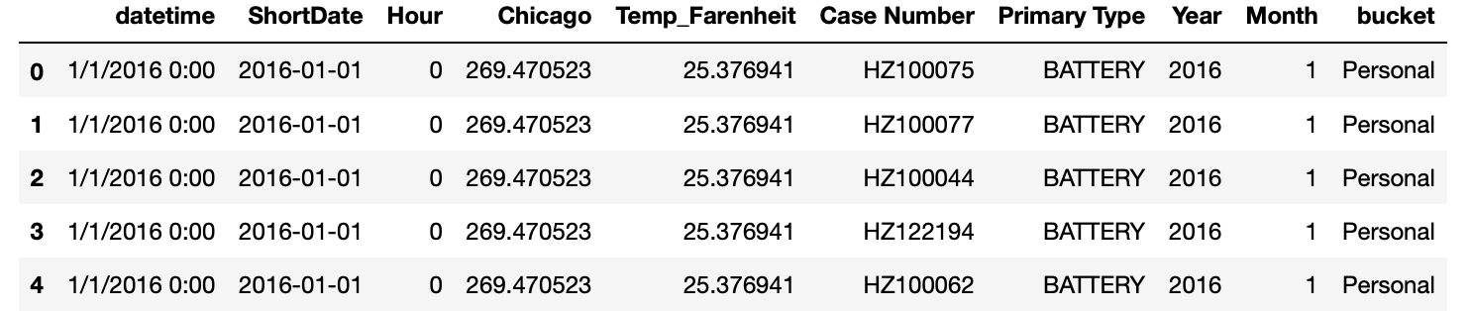
Clean data – combine data (2nd merge)
Observation: there are 35 primary types of crime
Action: group crime to 4 main categories

Slide 9

Definitions (Bins)
Crime Categories:
Personal: Battery, assault, offense involving children, sexual assault, sex offense, homicide, kidnapping, intimidation, stalking, obscenity, public indecency, human trafficking, domestic violence
Property: Theft, criminal damage, burglary, motor vehicle theft, deceptive practice, robbery, criminal trespass, arson
Statutory: Narcotics, weapons violation, interference with public officer, liquor law violation, other narcotic violation
Other: Prostitution, public peace violation, gambling, concealed carry license violation, non-criminal, ritualism

Slide 10
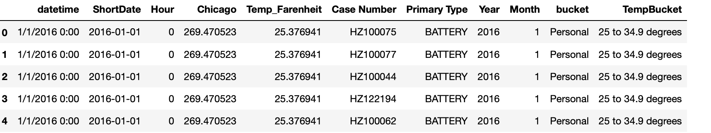
Clean data – final dataset
Observation: Crime temperature is from -9 to 91 Fahrenheit
Action: group temperature to 10 buckets for analysis purpose. So we can analyze the range of crime temperature

Slide 11
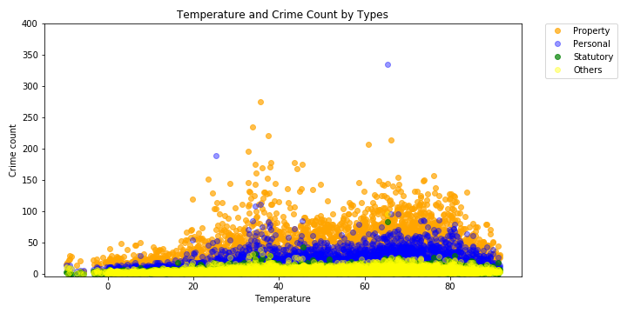
Analysis
We’ve seen some of the specific types of crime over the various temp ranges
How does the entire population stand out?

Slide 12
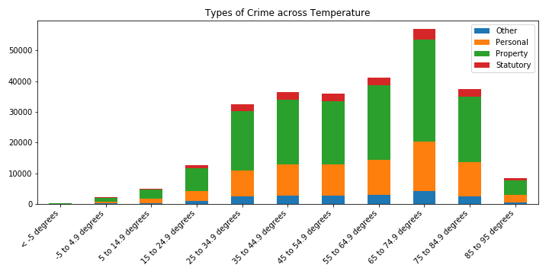
Analysis – Crime over Time
Back to the original question…
Is it the temperature that leads to more crime?
Buckets | % of Time in Range
< -5 degrees | 0.1%
-5 to 4.9 degrees | 1.1%
5 to 14.9 degrees | 2.4%
15 to 24.9 degrees | 5.5%
25 to 34.9 degrees | 13.3%
35 to 44.9 degrees | 14.6%
45 to 54.9 degrees | 13.9%
55 to 64.9 degrees | 15.2%
65 to 74.9 degrees | 20.3%
75 to 84.9 degrees | 11.3%
85 to 95 degrees | 2.3%

Slide 13
Analysis – Crime over Time

Slide 14
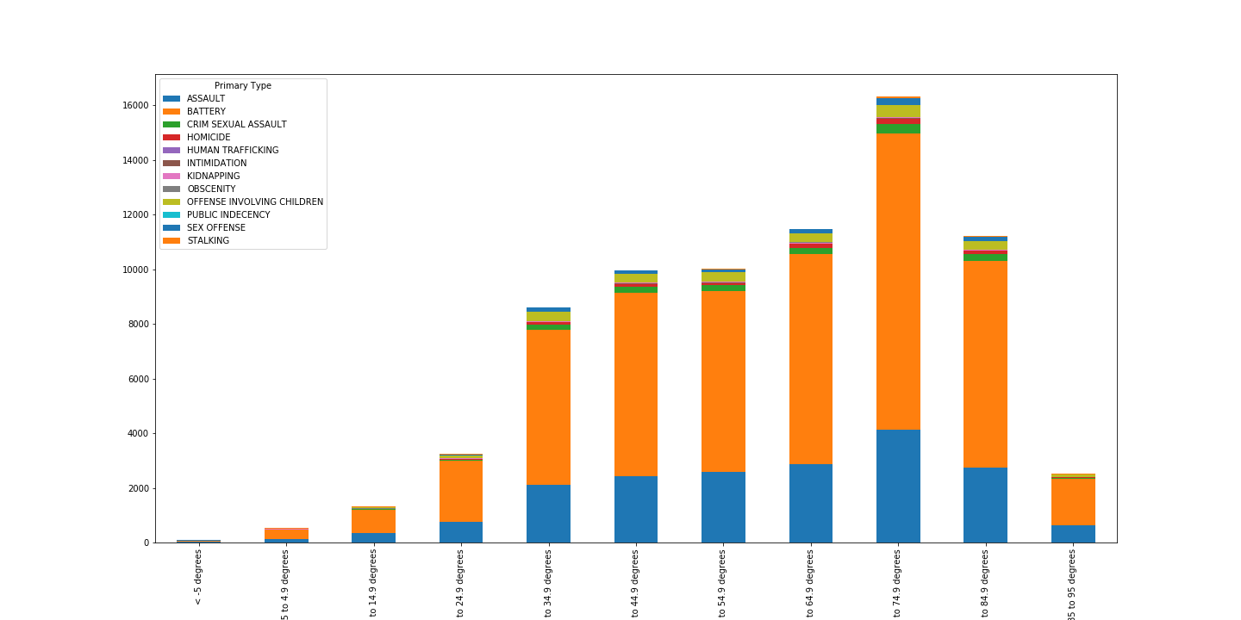
Personal Crimes

Slide 15
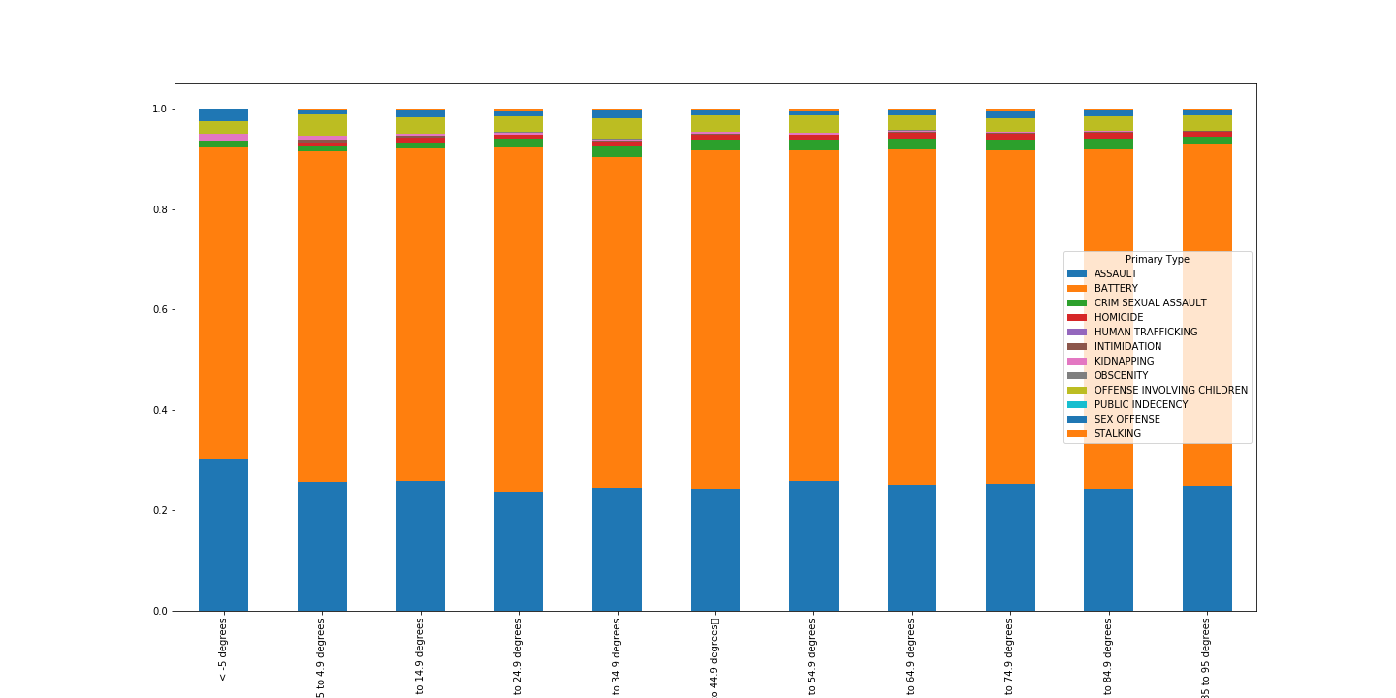
Personal Crimes Percentages

Slide 16
Personal Crimes Findings
In personal crimes, the top three crimes
Battery
Assault
Offense Involving Children
The crimes maintain the proportions from below zero to the highest possible temperature. There is no perceived correlation of certain crimes being more prominent then others. As the crimes seem to follow the same trend, the crimes seem to mimic the established trend being 65-74.9 Degree being the highest point.
TLDR: “if you are going to Chicago, I can tell you I don’t have much... But what I do have is a particular set of data; data I have acquired over a very short career. data that says you are going to get punched in the face. . . “
The personal crimes category contained the following
ASSAULT
BATTERY
CRIM SEXUAL ASSAULT
HOMICIDE
HUMAN TRAFFICKING
INTIMIDATION
KIDNAPPING
OBSCENITY
OFFENSE INVOLVING CHILDREN
PUBLIC INDECENCY
SEX OFFENSE
STALKING

Slide 17
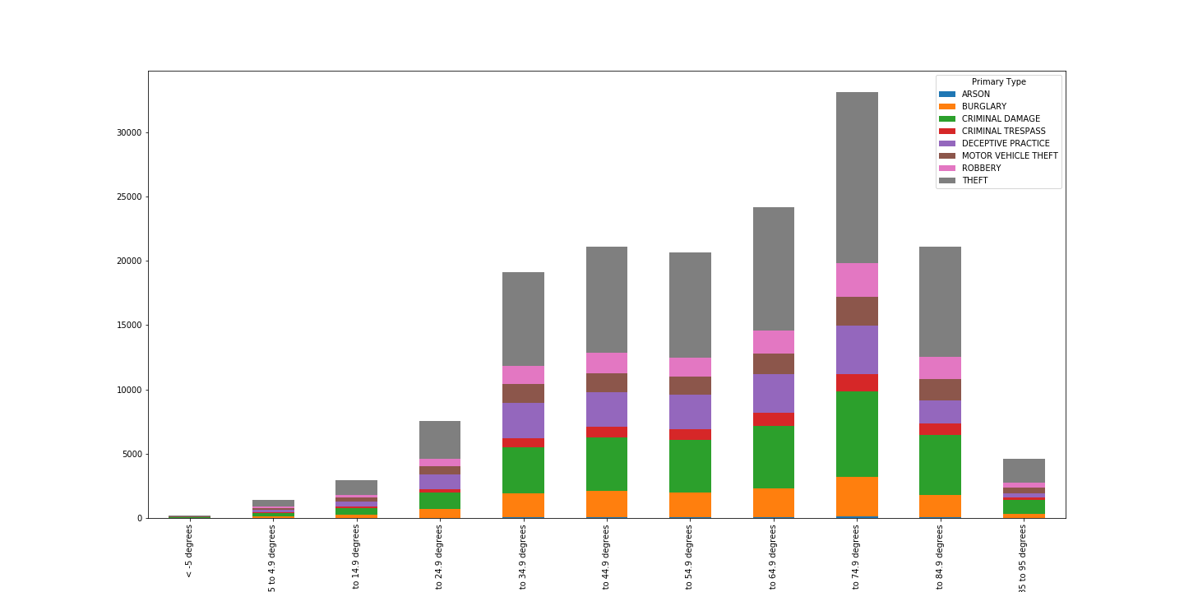
Property Crimes

Slide 18
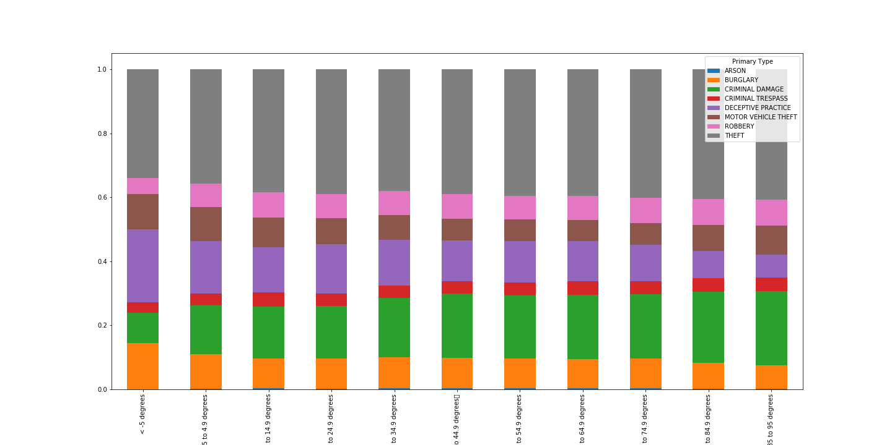
Property Crimes

Slide 19
Property Crimes Findings
The Personal crimes category contained the following were divided into the following crimes
ARSON
BURGLARY
CRIMINAL DAMAGE
CRIMINAL TRESPASS
DECEPTIVE PRACTICE
MOTOR VEHICLE THEFT
ROBBERY
THEFT
In property crimes, the top three crimes
Theft
Criminal Damage
Deceptive Practice
As noted before, aside from the peak crime being from being 65-74.9 Degree being the highest point. There is a slight difference to note that in the higher temperatures there is a greater chance of Property Damage and Theft, while at colder temperatures you have a slightly chance of being deceived or burgled.

Slide 20
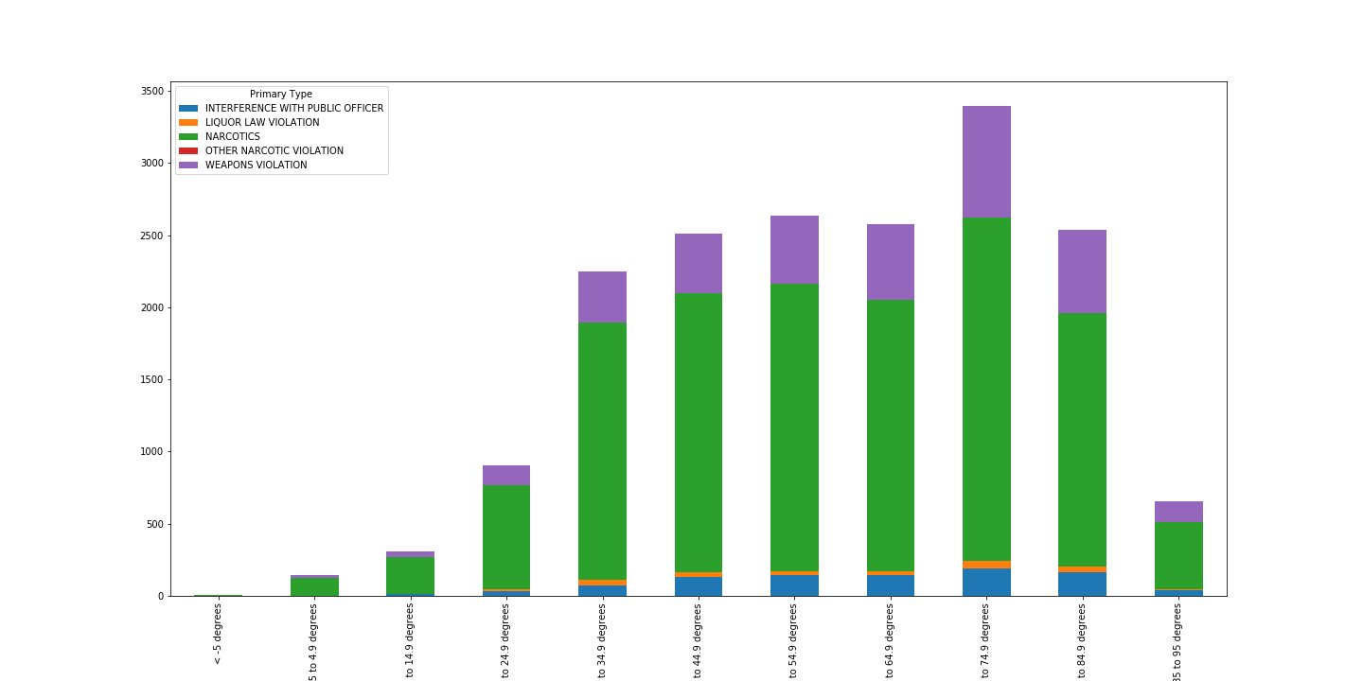
Statutory Crimes

Slide 21
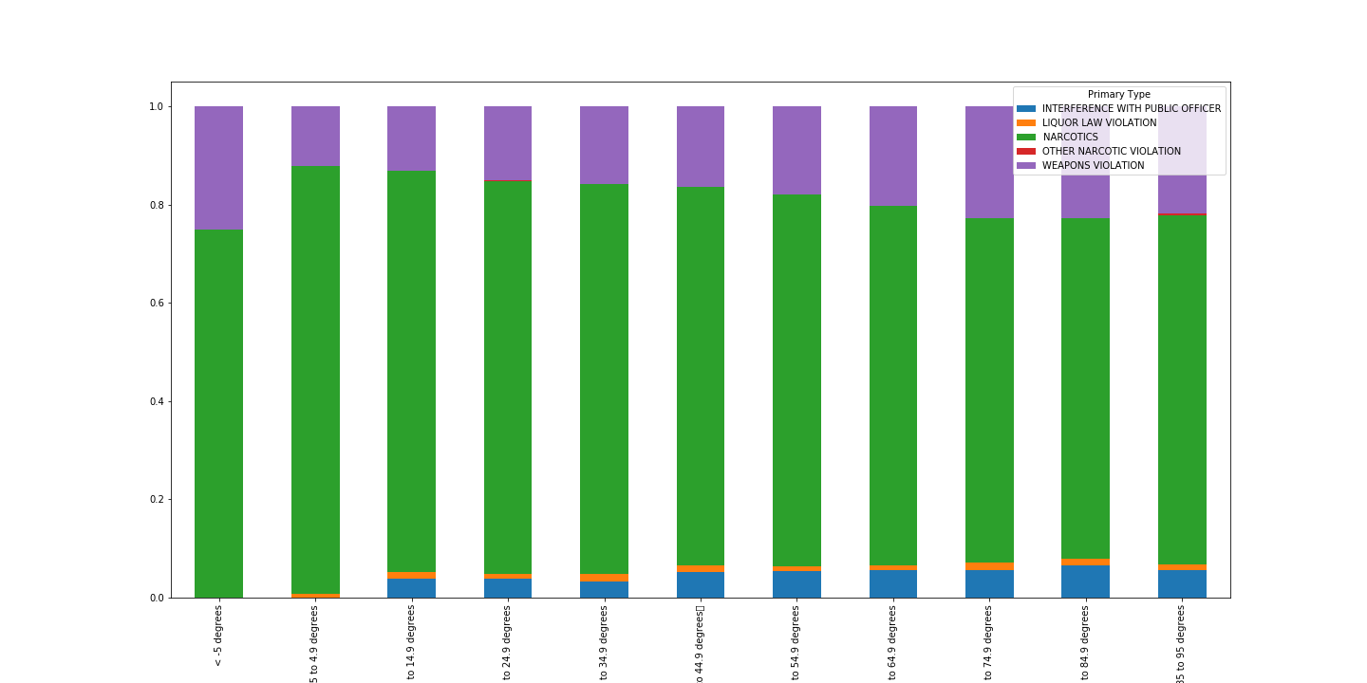
Statutory Crimes Percentages

Slide 22
Statutory Findings
The Statutory crimes category contained the following were divided into the following crimes
INTERFERENCE WITH PUBLIC OFFICER
LIQUOR LAW VIOLATION
NARCOTICS
OTHER NARCOTIC VIOLATION
WEAPONS VIOLATION
In Statutory crimes, the top three crimes
Narcotics
Weapons Violations
Interference with Public Officer
The most noteworthy findings is the slight increase of Weapons Violations and Interference with Public Officer that plateau at 75 to 85 degrees, and stays consistent to our maximum temperature grouping of 85 to 95. On the flip side Interference with Public Officers fall to zero from 4.9 to below -5 degrees.

Slide 23
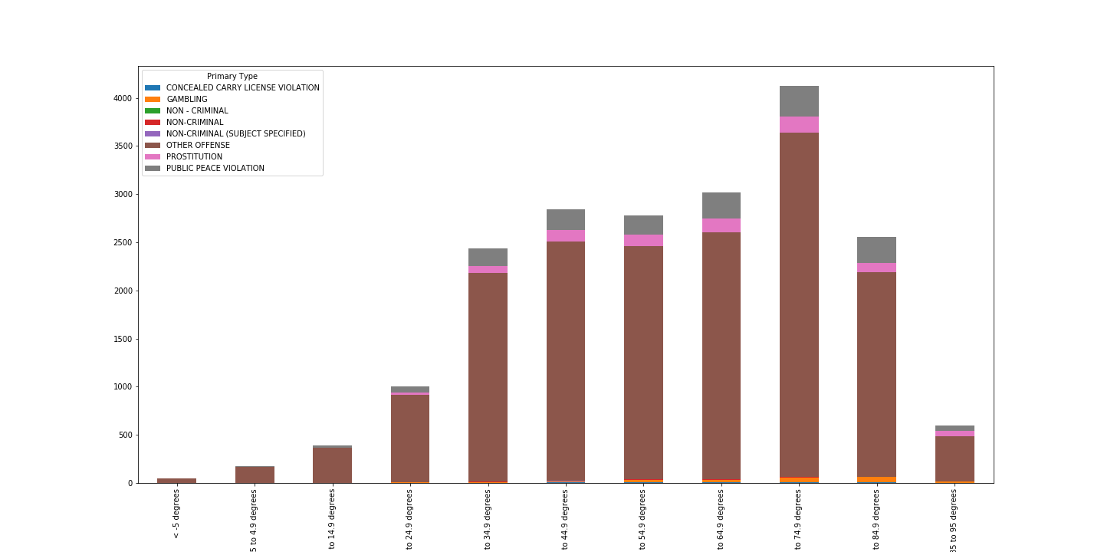
Other Crimes

Slide 24
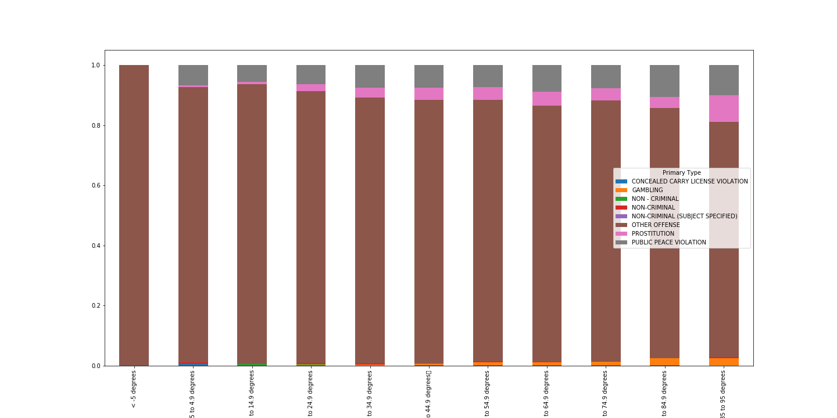
Other Crimes Percentages

Slide 25
Other Crimes Findings
The Other crimes category contained the following were divided into the following crimes, Note that the Chicago Police Department had a wide range of “Non-Criminal Crimes”.
CONCEALED CARRY LICENSE VIOLATION
GAMBLING
NON -CRIMINAL
NON-CRIMINAL (SUBJECT SPECIFIED)
OTHER OFFENSE
PROSTITUTION
PUBLIC PEACE VIOLATION
In Statutory crimes, the top three “identified” crimes
Public Peace Violations
Prostitutions
Gambling
With the identified crimes, aside from the usual quantitative trends, percentage wise, the end points are at the end of the temperature spectrum (-5 degrees to 95 degrees) with the peak being at 95, and the lowest reported at -5 degrees.

Slide 26
In Conclusion
With our original hypothesis “Is there a correlation between temperature and crime?” We have identified a high activity range from 25 to 85 degrees. With the “Golden Temperature” being 65 to 74.9 degrees. Majority of crimes are committed in the summer of Chicago, peaked at July.
However, there is no correlation on the preference of violent and non-violent crimes in certain temperature groups. (i.e Violence in hotter weathers )
Notes:
gerard

Slide 27
Moving Forward
A major point of contention is that correlation does not mean causation. However, moving forward this project is open for additional data input to reinforce our findings.
Expanding the years of weather and crime data, beyond 2016. To showcase consistency.
Potentially adding age, gender, and ethnic backgrounds of victims , offenders, and officers involved
Comparing, and contrasting with other cities with a similar socio-economic background. Such as New York, another bustling metropolitan with a diverse weather spectrum and San Francisco that is known for it’s mild consistent temperatures and weather forecast.

